Slide 1
Introduction to JavaScript
INE2720
Web Application Software Development
Essential Materials

Slide 2
Outline – Part A
Overview of JavaScript
  Versions, embedding, comments
JavaScript Basics
  Variables and Data Types
  Operators
  Expressions
JavaScript Control Structures
  Conditional Statements
  Looping Statements

Slide 3
Outline – Part B
JavaScript Functions and Events
  Events Handlers
Using Object in JavaScript
  Object-Oriented Programming
  JavaScript Object Model
  Using Built-In objects (Predefined Object)
  Custom Object Types
Error in JavaScript
Exception Handling in JavaScript
All copyrights reserved by C.C. Cheung 2003.

Slide 4
Outline – Part C
Working with Browser Objects
  Document Object Model (DOM)
Creating Cookies in JavaScript
  Constructing a standard cookie
  Interaction with the cookie
Introducing DHTML
  Styles and Layers
  Dynamic Positioning
INE2720 – Web Application Software Development
All copyrights reserved by C.C. Cheung 2003.

Slide 5
Outline – Part D
JavaScript Application Development
  JavaScript Example
  Discuss the execution requirements
  How to break down the syntax
Cool JavaScript Sites
JavaScript and DHTML Reference
Hints for JavaScript coding
Summary
INE2720 – Web Application Software Development
All copyrights reserved by C.C. Cheung 2003.

Slide 6
Introduction
The growth of the WWW has resulted in a demand for dynamic and interactive web sites.
There are many different kinds of scripting languages – JavaScript, …
This lecture aims at offering in-depth knowledge of JavaScript, discussing the complexity of scripting and studying various common examples.
INE2720 – Web Application Software Development
All copyrights reserved by C.C. Cheung 2003.

Slide 7
JavaScript Capabilities
Improve the user interface of a website
Make your site easier to navigate
Easily create pop-up alert, windows
Replace images on a page without reload the page
Form validation
Many others …
INE2720 – Web Application Software Development
All copyrights reserved by C.C. Cheung 2003.

Slide 8
JavaScript Versions
JavaScript 1.0
  Supported by Netscape 2.0 and IE 3.0
JavaScript 1.1
  Supported by Netscape 3.0 and IE 4.0
JavaScript 1.2
  Supported by Netscape 4.0 and IE 4.0
JavaScript 1.3
  Supported by Netscape 4.5 and IE 5.0
JavaScript 1.5
  Supported by Netscape 6.0 and IE 5.5 and later
INE2720 – Web Application Software Development
All copyrights reserved by C.C. Cheung 2003.

Slide 9
The Future of JavaScript
ECMA standard brings JavaScript and Jscript together.
  ECMA - An International industry association dedicated to standardize information and communication systems.
Both Netscape and Microsoft have pledged that they will support and develop JavaScript in the future.
It is future-proof, and it is not going to disappear in the near future. ☺
INE2720 – Web Application Software Development
All copyrights reserved by C.C. Cheung 2003.

Slide 10
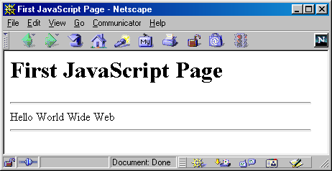
A Simple Script
<html>
<head> <title>First JavaScript Page</title> </head>
<body>
<h1>First JavaScript Page</h1>
<script type="text/javascript">
<!--
document.write("<hr>");
document.write("Hello World Wide Web");
document.write("<hr>");
-->
</script>
</body>
</html>
INE2720 – Web Application Software Development
All copyrights reserved by C.C. Cheung 2003.

Slide 11
Embedding JavaScript
<html>
<head>
<title>First JavaScript Program</title>
</head>
<body>
<script language=“JavaScript” src=“your_source_file.js”></script>
</body>
</html>
A <script> tag can be placed either within the <head> or <body> tag of an HTML document.
INE2720 – Web Application Software Development
All copyrights reserved by C.C. Cheung 2003.

Slide 12
JavaScript Source File
<script language=“JavaScript”
src=“your_source_file.js”></script>
SRC – specifies the location of an external script
TYPE – specifies the scripting language of the script
LANGUAGE – specifies the scripting language of the script
TYPE and LANGUAGE have a similar function, we use LANGUAGE to specify the language used in the script
INE2720 – Web Application Software Development
All copyrights reserved by C.C. Cheung 2003.

Slide 13
Need for a source file
If the JavaScript code is fairly short, you are recommended to include the code in the HTML document.
To add clarity to an HTML document.
To share JavaScript code across multiple HTML documents.
To help you hide your JavaScript code.
  Spent lot of time for JavaScript coding.
  Viewer can only see the location of the source file but not the contents.
INE2720 – Web Application Software Development
All copyrights reserved by C.C. Cheung 2003.

Slide 14
Hide JavaScript from incompatible browsers
<script language=“JavaScript”>
<!– begin hiding JavaScript
// single-line comment, /* … */ multiple-line comment
End hiding JavaScript -->
</script>
<noscript>
Your browser does not support JavaScript.
</noscript>
Not all browsers support JavaScript.
E.g. NN1, IE2, character-based lynx.
INE2720 – Web Application Software Development
All copyrights reserved by C.C. Cheung 2003.

Slide 15
JavaScript confusion
JavaScript | Java
Interpreted by the client-side computer | Compiled on the server before executed on the client machine
Dynamic binding, object references are checked at runtime | Static binding, object references must exist at compile time
No need to declare data types | Data types must be declared
Code is embedded in HTML | Code is not integrated in HTML
Limited by the browser functionality | Java applications are standalone
Can access browser objects | Java has no access to browser objects
INE2720 – Web Application Software Development
All copyrights reserved by C.C. Cheung 2003.

Slide 16
Using the alert() Method
<head>
<script language=“JavaScript”>
alert(“An alert triggered by JavaScript”);
</script>
</head>
It is the easiest methods to use amongst alert(), prompt() and confirm().
You can use it to display textual information to the user (simple and concise).
The user can simply click “OK” to close it.
INE2720 – Web Application Software Development
All copyrights reserved by C.C. Cheung 2003.

Slide 17
Using the confirm() Method
<head>
<script language=“JavaScript”>
confirm(“Are you happy with the class?”);
</script>
</head>
This box is used to give the user a choice either OK or Cancel.
It is very similar to the “alert()” method.
You can also put your message in the method.
INE2720 – Web Application Software Development
All copyrights reserved by C.C. Cheung 2003.

Slide 18
Using the alert() Method
<head>
<script language=“JavaScript”>
prompt(“What is your student id number?”);
prompt(“What is your name?”,”No name”);
</script>
</head>
This is the only one that allows the user to type in his own response to the specific question.
You can give a default value to avoid displaying “undefined”.
INE2720 – Web Application Software Development
All copyrights reserved by C.C. Cheung 2003.

Slide 19
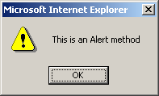
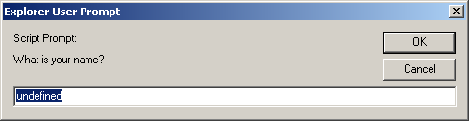
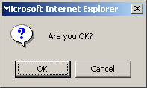
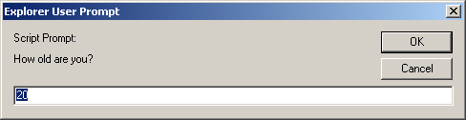
Three methods
<script language="JavaScript">
alert("This is an Alert method");
confirm("Are you OK?");
prompt("What is your name?");
prompt("How old are you?","20");
</script>
INE2720 – Web Application Software Development
All copyrights reserved by C.C. Cheung 2003.

Slide 20
Variables
JavaScript allows you to declare and use variables to store values.
How to assign a name to a variable?
  Include uppercase and lowercase letters
  Digits from 0 through 9
  The underscore _ and the dollar sign $
  No space and punctuation characters
  First character must be alphabetic letter or underscore – 99Total?, 012345number?, …
  Case-sensitive
  No reserved words or keywords
INE2720 – Web Application Software Development
All copyrights reserved by C.C. Cheung 2003.

Slide 21
Which one is legal?
My_variable
$my_variable
1my_example
_my_variable
@my_variable
My_variable_example
++my_variable
%my_variable
#my_variable
~my_variable
myVariableExample
Legal
Illegal
INE2720 – Web Application Software Development
All copyrights reserved by C.C. Cheung 2003.

Slide 22
Variable on-the-fly
<head>
<script language=“JavaScript”>
var id;
id = prompt(“What is your student id number?”);
alert(id);
name = prompt(“What is your name?”,”No name”);
alert(name);
</script>
</head>
Variable declaration
We should use “var” because it is more easy to keep track of the variables.
INE2720 – Web Application Software Development
All copyrights reserved by C.C. Cheung 2003.

Slide 23
Data Types
JavaScript allows the same variable to contain different types of data values.
Primitive data types
  Number: integer & floating-point numbers
  Boolean: logical values “true” or “false”
  String: a sequence of alphanumeric characters
Composite data types (or Complex data types)
  Object: a named collection of data
  Array: a sequence of values
Special data types
  Null: an initial value is assigned
  Undefined: the variable has been created by not yet assigned a value
INE2720 – Web Application Software Development
All copyrights reserved by C.C. Cheung 2003.

Slide 24
Numeric Data Types
It is an important part of any programming language for doing arithmetic calculations.
JavaScript supports:
  Integers: A positive or negative number with no decimal places.
    Ranged from –2⁵³ to 2⁵³
  Floating-point numbers: usually written in exponential notation.
    3.1415…, 2.0e11
INE2720 – Web Application Software Development
All copyrights reserved by C.C. Cheung 2003.

Slide 25
Integer and Floating-point number example
<script language=“JavaScript”>
var integerVar = 100;
var floatingPointVar = 3.0e10;
// floating-point number 30000000000
document.write(integerVar);
document.write(floatingPointVar);
</script>
The integer 100 and the number 30,000,000,000 will be appeared in the browser window.
INE2720 – Web Application Software Development
All copyrights reserved by C.C. Cheung 2003.

Slide 26
Boolean Values
A Boolean value is a logical value of either true or false. (yes/no, on/off)
Often used in decision making and data comparison.
In JavaScript, you can use the words “true” and “false” directly to indicate Boolean values.
Named by the 19th century mathematician “George Boole”.
INE2720 – Web Application Software Development
All copyrights reserved by C.C. Cheung 2003.

Slide 27
Boolean value example
<head>
<script language=“JavaScript”>
var result;
result = (true*10 + false*7);
alert(“true*10 + false*7 = “, result);
</script>
</head>
The expression is converted to
  (1*10 + 0*7) = 10
They are automatically converted.
INE2720 – Web Application Software Development
All copyrights reserved by C.C. Cheung 2003.

Slide 28
Strings
A string variable can store a sequence of alphanumeric characters, spaces and special characters.
String can also be enclosed in single quotation marks (‘) or in double quotation marks (“).
What is the data type of “100”?
  String but not number type
Pay attention to the special characters.
INE2720 – Web Application Software Development
All copyrights reserved by C.C. Cheung 2003.

Slide 29
Strings example
<head>
<script language=“JavaScript”>
document.write(“This is a string.”);
document.write(“This string contains ‘quote’.”);
var myString = “My testing string”;
alert(myString);
</script>
</head>
Unlike Java and C, JavaScript does not have a single character (char) data type.
INE2720 – Web Application Software Development
All copyrights reserved by C.C. Cheung 2003.

Slide 30
typeof operator
<head>
<script language=“JavaScript”>
var x = “hello”, y;
alert(“Variable x value is “ + typeof(x));
alert(“Variable y value is “ + typeof(y));
alert(“Variable x value is “ + typeof(z));
</script>
</head>
It is an unary operator.
  Return either: Number, string, Boolean, object, function, undefined, null
INE2720 – Web Application Software Development
All copyrights reserved by C.C. Cheung 2003.

Slide 31
What is an Object?
An object is a thing, anything, just as things in the real world.
  E.g. (cars, dogs, money, books, … )
In the web browser, objects are the browser window itself, forms, buttons, text boxes, …
Methods are things that objects can do.
  Cars can move, dogs can bark.
  Window object can alert the user “alert()”.
All objects have properties.
  Cars have wheels, dogs have fur.
  Browser has a name and version number.
INE2720 – Web Application Software Development
All copyrights reserved by C.C. Cheung 2003.

Slide 32
Array
An Array contains a set of data represented by a single variable name.
Arrays in JavaScript are represented by the Array Object, we need to “new Array()” to construct this object.
The first element of the array is “Array[0]” until the last one Array[i-1].
E.g. myArray = new Array(5)
  We have myArray[0,1,2,3,4].
INE2720 – Web Application Software Development
All copyrights reserved by C.C. Cheung 2003.

Slide 33
Array Example
<script language=“JavaScript”>
Car = new Array(3);
Car[0] = “Ford”;
Car[1] = “Toyota”;
Car[2] = “Honda”;
document.write(Car[0] + “<br>”);
document.write(Car[1] + “<br>”);
document.write(Car[2] + “<br>”);
</script>
You can also declare arrays with variable length.
  arrayName = new Array();
  Length = 0, allows automatic extension of the length.
  Car[9] = “Ford”; Car[99] = “Honda”;
INE2720 – Web Application Software Development
All copyrights reserved by C.C. Cheung 2003.

Slide 34
Null & Undefined
An “undefined” value is returned when you attempt to use a variable that has not been defined or you have declared but you forgot to provide with a value.
Null refers to “nothing”
You can declare and define a variable as “null” if you want absolutely nothing in it, but you just don’t want it to be “undefined”.
INE2720 – Web Application Software Development
All copyrights reserved by C.C. Cheung 2003.

Slide 35
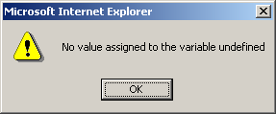
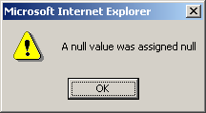
Null & Undefined example
<html>
<head>
<title> Null and Undefined example </title>
<script language=“JavaScript”>
var test1, test2 = null;
alert(“No value assigned to the variable” + test1);
alert(“A null value was assigned” + test2);
</script>
</head>
<body> … </body>
</html>
INE2720 – Web Application Software Development
All copyrights reserved by C.C. Cheung 2003.

Slide 36
JavaScript Special Characters
Character | Meaning
\b | Backspace
\f | Form feed
\t | Horizontal tab
\n | New line
\r | Carriage return
\\ | Backslash
\’ | Single quote
\” | Double quote
INE2720 – Web Application Software Development
All copyrights reserved by C.C. Cheung 2003.

Slide 37

Break Time – 10 minutes
INE2720 – Web Application Software Development
All copyrights reserved by C.C. Cheung 2003.

Slide 38
Expressions
It is a set of literals, variables, operators that merge and evaluate to a single value.
  Left_operand operator right_operand
By using different operators, you can create the following expressions.
  Arithmetic, logical
  String and conditional expressions.
INE2720 – Web Application Software Development
All copyrights reserved by C.C. Cheung 2003.

Slide 39
Operators
Arithmetic operators
Logical operators
Comparison operators
String operators
Bit-wise operators
Assignment operators
Conditional operators
INE2720 – Web Application Software Development
All copyrights reserved by C.C. Cheung 2003.

Slide 40
Arithmetic operators
left_operand “operator” right_operand
Operator | Name | Description | Example
+ | Addition | Adds the operands | 3 + 5
- | Subtraction | Subtracts the right operand from the left operand | 5 - 3
* | Multiplication | Multiplies the operands | 3 * 5
/ | Division | Divides the left operand by the right operand | 30 / 5
% | Modulus | Calculates the remainder | 20 % 5
INE2720 – Web Application Software Development
All copyrights reserved by C.C. Cheung 2003.

Slide 41
Unary Arithmetic Operators
Binary operators take two operands.
Unary type operators take only one operand.
Which one add value first, and then assign value to the variable?
Name | Example
Post Incrementing operator | Counter++
Post Decrementing operator | Counter--
Pre Incrementing operator | ++counter
Pre Decrementing operator | --counter
INE2720 – Web Application Software Development
All copyrights reserved by C.C. Cheung 2003.

Slide 42
Logical operators
Used to perform Boolean operations on Boolean operands
Operator | Name | Description | Example
&& | Logical and | Evaluate to “true” when both operands are true | 3>2 && 5<2
|| | Logical or | Evaluate to “true when either operand is true | 3>1 || 2>5
! | Logical not | Evaluate to “true” when the operand is false | 5 != 3
INE2720 – Web Application Software Development
All copyrights reserved by C.C. Cheung 2003.

Slide 43
Comparison operators
Used to compare two numerical values
Operator | Name | Description | Example
== | Equal | Perform type conversion before checking the equality | “5” == 5
=== | Strictly equal | No type conversion before testing | “5” === 5
!= | Not equal | “true” when both operands are not equal | 4 != 2
!== | Strictly not equal | No type conversion before testing nonequality | 5 !== “5”
> | Greater than | “true” if left operand is greater than right operand | 2 > 5
< | Less than | “true” if left operand is less than right operand | 3 < 5
>= | Greater than or equal | “true” if left operand is greater than or equal to the right operand | 5 >= 2
<= | Less than or equal | “true” if left operand is less than or equal to the right operand | 5 <= 2
INE2720 – Web Application Software Development
All copyrights reserved by C.C. Cheung 2003.

Slide 44
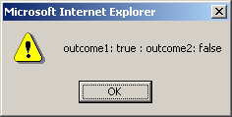
Strict Equality Operators
<script language=“JavaScript”>
var currentWord=“75”;
var currentValue=75;
var outcome1=(currentWord == currentValue);
var outcome2=(currentWord === currentValue);
alert(“outcome1: “ + outcome1 + “ : outcome2: “ + outcome2);
</script>
Surprised that outcome1 is True!
JavaScript tries very hard to resolve numeric and string differences.
INE2720 – Web Application Software Development
All copyrights reserved by C.C. Cheung 2003.

Slide 45
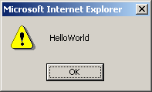
String operator
JavaScript only supports one string operator for joining two strings.
Operator | Name | Description | Return value
+ | String concatenation | Joins two strings | “HelloWorld”
<script language=“JavaScript”>
var myString = “”;
myString = “Hello” + “World”;
alert(myString);
</script>
INE2720 – Web Application Software Development
All copyrights reserved by C.C. Cheung 2003.

Slide 46
Bit Manipulation operators
Perform operations on the bit representation of a value, such as shift left or right.
Operator | Name | Description
& | Bitwise AND | Examines each bit position
| | Bitwise OR | If either bit of the operands is 1, the result will be 1
^ | Bitwise XOR | Set the result bit, only if either bit is 1, but not both
<< | Bitwise left shift | Shifts the bits of an expression to the left
>> | Bitwise signed right shift | Shifts the bits to the right, and maintains the sign
>>> | Bitwise zero-fill right shift | Shifts the bits of an expression to right
INE2720 – Web Application Software Development
All copyrights reserved by C.C. Cheung 2003.

Slide 47
Assignment operators
Used to assign values to variables
Operator | Description | Example
= | Assigns the value of the right operand to the left operand | A = 2
+= | Add the operands and assigns the result to the left operand | A += 5
-= | Subtracts the operands and assigns the result to the left operand | A -= 5
*= | Multiplies the operands and assigns the result to the left operand | A *= 5
/= | Divides the left operands by the right operand and assigns the result to the left operand | A /= 5
%= | Assigns the remainder to the left operand | A %= 2
INE2720 – Web Application Software Development
All copyrights reserved by C.C. Cheung 2003.

Slide 48
The most common problem
<script language=“JavaScript”>
if (alpha = beta) { … }
if (alpha == beta) { … }
</script>
Don’t mix the comparison operator and the assignment operator.
double equal sign (==) and the equal operator (=)
INE2720 – Web Application Software Development
All copyrights reserved by C.C. Cheung 2003.

Slide 49
Order of Precedence
Precedence | Operator
1 | Parentheses, function calls
2 | , ~, -, ++, --, new, void, delete
3 | *, /, %
4 | +, -
5 | <<, >>, >>>
6 | <, <=, >, >=
7 | ==, !=, ===, !==
8 | &
9 | ^
10 | |
11 | &&
12 | ||
13 | ?:
14 | =, +=, -=, *=, …
15 | The comma (,) operator
INE2720 – Web Application Software Development
All copyrights reserved by C.C. Cheung 2003.

Slide 50
Precedence Example
Value = (19 % 4) / 1 – 1 - !false
Value = 3 / 1 – 1 - !false
Value = 3 / 1 – 1 - true
Value = 3 – 1 - true
Value = 3 – 2
Value = 1
INE2720 – Web Application Software Development
All copyrights reserved by C.C. Cheung 2003.

Slide 51
Scope of a Variable
When you use a variable in a JavaScript program that uses functions.
A global scope variable is one that is declared outside a function and is accessible in any part of your program.
A local variable is declared inside a function and stops existing when the function ends.
INE2720 – Web Application Software Development
All copyrights reserved by C.C. Cheung 2003.

Slide 52
Example of variable, data types
<html><head><title> Billing System of Web Shoppe </title></head><body>
<h1 align="center"> Billing System of Web Shoppe </h1>
<script language="JavaScript">
firstCustomer = new Array();
billDetails = new Array(firstCustomer);
var custName, custDob, custAddress, custCity, custPhone;
var custAmount, custAmountPaid, custBalAmount;
custName=prompt("Enter the first customer's name:", "");
custDob=prompt("Enter the first customer's date of birth:", "");
custAddress=prompt("Enter the first customer's address:", "");
custPhone=prompt("Enter the first customer's phone number:", "");
custAmount=prompt("Enter the total bill amount of the first customer:", "");
custAmountPaid=prompt("Enter the amount paid by the first customer:", "");
custBalAmount = custAmount - custAmountPaid;
firstCustomer[0]=custName;
firstCustomer[1]=custDob;
firstCustomer[2]=custAddress;
firstCustomer[3]=custPhone;
firstCustomer[4]=custBalAmount;
document.write("<B>" + "You have entered the following details for first customer:" + "<BR>");
document.write("Name: " + billDetails[0][0] + "<BR>");
document.write("Date of Birth: " + billDetails[0][1] + "<BR>");
document.write("Address: " + billDetails[0][2] + "<BR>");
document.write("Phone: " + billDetails[0][3] + "<BR>");
(custBalAmount == 0) ? document.write("Amount Outstanding: " + custBalAmount):document.write("No amount due")
</script></body></html>
INE2720 – Web Application Software Development
All copyrights reserved by C.C. Cheung 2003.

Slide 53
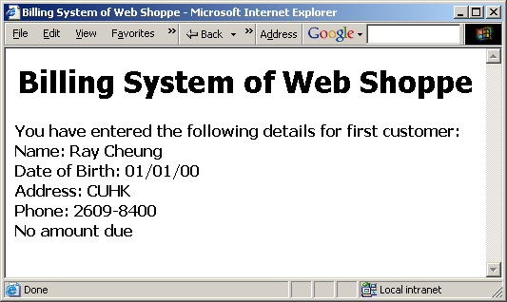
Output of the code
INE2720 – Web Application Software Development
All copyrights reserved by C.C. Cheung 2003.

Slide 54
Conditional Statement
“if” statement
“if … else” statement
“else if” statement
“if/if … else” statement
“switch” statement
INE2720 – Web Application Software Development
All copyrights reserved by C.C. Cheung 2003.

Slide 55
“if” statement
if (condition) { statements; }
It is the main conditional statement in JavaScript.
The keyword “if” always appears in lowercase.
The condition yields a logical true or false value.
The condition is true, statements are executed.
INE2720 – Web Application Software Development
All copyrights reserved by C.C. Cheung 2003.

Slide 56
“if” statement example
<script language=“JavaScript”>
var chr = “”;
…
if (chr == ‘A’ || chr == ‘O’) {
document.write(“Vowel variable”);
}
</script>
“||” operator - increase the speed of the script
INE2720 – Web Application Software Development
All copyrights reserved by C.C. Cheung 2003.

Slide 57
“if … else” statement
if (condition) { statements; }
else { statements; }
You can include an “else” clause in an if statement when you want to execute some statements if the condition is false.
INE2720 – Web Application Software Development
All copyrights reserved by C.C. Cheung 2003.

Slide 58
Ternary Shortcut (concise)
<script language=“JavaScript”>
If (3 > 2) {
alert(“True”);
} else {
alert(“False”);
}
(3 > 2) ? alert(“True”) : alert(“False”);
</script>
Substitute for a simple “if/else” statement.
INE2720 – Web Application Software Development
All copyrights reserved by C.C. Cheung 2003.

Slide 59
“else if” statement
if (condition) { statement; }
else if (condition) { statement; }
else { statement; }
Allows you to test for multiple expression for one true value and executes a particular block of code.
INE2720 – Web Application Software Development
All copyrights reserved by C.C. Cheung 2003.

Slide 60
“if/if…else” statement example
<script language=“JavaScript”>
var chr;
chr = prompt(“Please enter a character : “,””);
if (chr >= ‘A’){
if (chr <= ‘Z’)
alert(“Uppercase”);
else if (chr >= ‘a’){
alert(“Lowercase”);
}
}
</script>
INE2720 – Web Application Software Development
All copyrights reserved by C.C. Cheung 2003.

Slide 61
“switch” statement
switch (expression) {
case label1:
statements; break;
default:
statements;
}
Allows you to merge several evaluation tests of the same variable into a single block of statements.
INE2720 – Web Application Software Development
All copyrights reserved by C.C. Cheung 2003.

Slide 62
“switch” statement example
<script language=“JavaScript”>
var chr;
chr = prompt(“Pls enter a character in lowercase:”,””);
switch(chr){
case ‘a’ :
alert(“Vowel a”); break;
case ‘e’ :
alert(“Vowel e”); break;
default :
alert(“Not a vowel”);
}
</script>
INE2720 – Web Application Software Development
All copyrights reserved by C.C. Cheung 2003.

Slide 63
Looping Statement
“for” Loops
“for/in” Loops
“while” Loops
“do … while” Loops
“break” statement
“continue” statement
INE2720 – Web Application Software Development
All copyrights reserved by C.C. Cheung 2003.

Slide 64
“for” statement
for (initial_expression; test_exp; change_exp)
{ statements; }
One of the most used and familiar loops is the for loop.
It iterates through a sequence of statements for a number of times controlled by a condition.
The change_exp determines how much has been added or subtracted from the counter variable.
INE2720 – Web Application Software Development
All copyrights reserved by C.C. Cheung 2003.

Slide 65
“for” statement example
<script language=“JavaScript”>
var counter;
for (counter = 1; counter <= 10; counter++)
{
document.write(counter*counter + “ “);
}
</script>
Display the square of numbers
Output: 1 4 9 16 25 36 49 64 81 100
INE2720 – Web Application Software Development
All copyrights reserved by C.C. Cheung 2003.

Slide 66
“for/in” statement
for (counter_variable in object)
{ statements; }
When the for/in statement is used, the counter and termination are determined by the length of the object.
The statement begins with 0 as the initial value of the counter variable, terminates with all the properties of the objects have been exhausted.
  E.g. array → no more elements found
INE2720 – Web Application Software Development
All copyrights reserved by C.C. Cheung 2003.

Slide 67
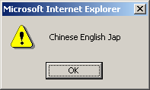
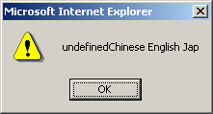
“for/in” statement example
<script language=“JavaScript”>
var book; (What is the difference if “var book=“”;)
var booklist = new Array(“Chinese”, “English”, “Jap”);
for (var counter in booklist) {
book += booklist[counter] + “ “;
}
alert(book);
</script>
INE2720 – Web Application Software Development
All copyrights reserved by C.C. Cheung 2003.

Slide 68
“while” statement
initial value declaration;
while (condition) {
statements;
increment/decrement statement;
}
The while loop begins with a termination condition and keeps looping until the termination condition is met.
The counter variable is managed by the context of the statements inside the curly braces.
INE2720 – Web Application Software Development
All copyrights reserved by C.C. Cheung 2003.

Slide 69
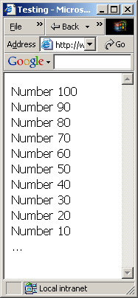
“While” statement example
<html>
<head>
<title>While loop example</title>
<script language=“JavaScript”>
var counter = 100;
var numberlist = “”;
while (counter > 0) {
  numberlist += “Number “ + counter + “<br>”;
  counter -= 10;
}
document.write(numberlist);
</script> <body> … </body>
</html>
INE2720 – Web Application Software Development
All copyrights reserved by C.C. Cheung 2003.

Slide 70
“do … while” statement
do {
statements;
counter increment/decrement;
} while (termination condition)
The do/while loop always executes statements in the loop in the first iteration of the loop.
The termination condition is placed at the bottom of the loop.
INE2720 – Web Application Software Development
All copyrights reserved by C.C. Cheung 2003.

Slide 71
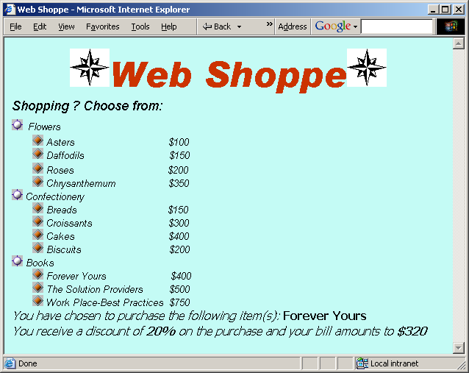
Example of Flow Control
INE2720 – Web Application Software Development
All copyrights reserved by C.C. Cheung 2003.

Slide 72

References
Deitel: Chapter 7, 8, 9, 11
CWP: Chapter 24
Making use of JavaScript
SAMS JavaScript
The End.
Thank you for patience!
INE2720 – Web Application Software Development
All copyrights reserved by C.C. Cheung 2003.

